Slide 1
Windows Tech Series Series Overview – Value Proposition
Speaker 1
Title
Speaker 2
Title

Slide 2
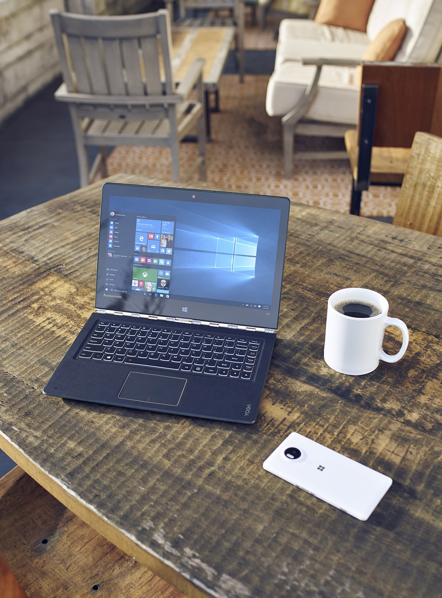
Agenda
Team Introductions
Schedule
Logistics
Overview of Windows 10 Anniversary Update
Windows 10 Value Proposition
Notes:
Title: Objectives
Length: 2 minutes
<Instructional Designer: List the module learning objectives here. You can use longer descriptions than slide bullets if you want to.>
Start Time xx:xx / Length: 2 minutes
Review the learning objectives.

Slide 3
Agenda
Day | Day 1 Deployment | Day 2 Management | Day 3 Security | Day 4 Windows for CSP
 |  |  |  | Deployment | Management | Security
Synopsis | Module 1 – Introduction | Module 1 – Base System Setup | Module 1 – Analysis Of Common Threats | Module 1 – Windows for SMB Partners
 | Module 2 – Applications & Updates | Module 2 – Configuration | Module 2 – Hardening Windows | Module 2 – Windows Ent. Subscription
 | Module 3 – Windows as a Service (WaaS) | Module 3 – Managing Client Devices | Module 3 – Advanced Threat Protection | Module 3 – Deployment
 | Module 4 – Browsers & Internet Security | Module 4 – Advanced Client Management | Module 4 – Information Security (RMS/EDP) | Module 4 – Managing Updates
 | Module 5 – Secure Boot & Device Guard |  | Module 5 – Internet Security

Slide 4
Logistics
Restrooms
Breakrooms/Coffee
Building Hours
Breaks and Lunches
Classroom organization / Wi-Fi / etc.

Slide 5


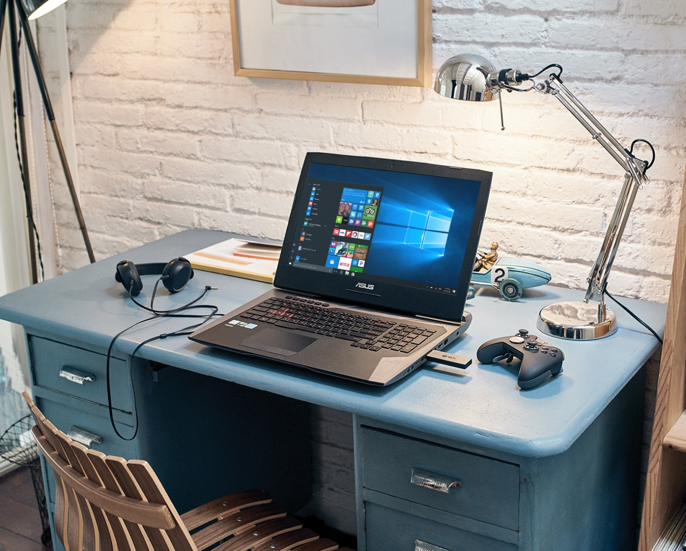
Windows 10 Progress Update
Notes:
PROFITABILITY Thanks for the introduction. We get it. Windows 10 is well-received by businesses, and it’s really important to enable our Cloud Services Business. Now tell us about the CASH $$!!

Slide 6
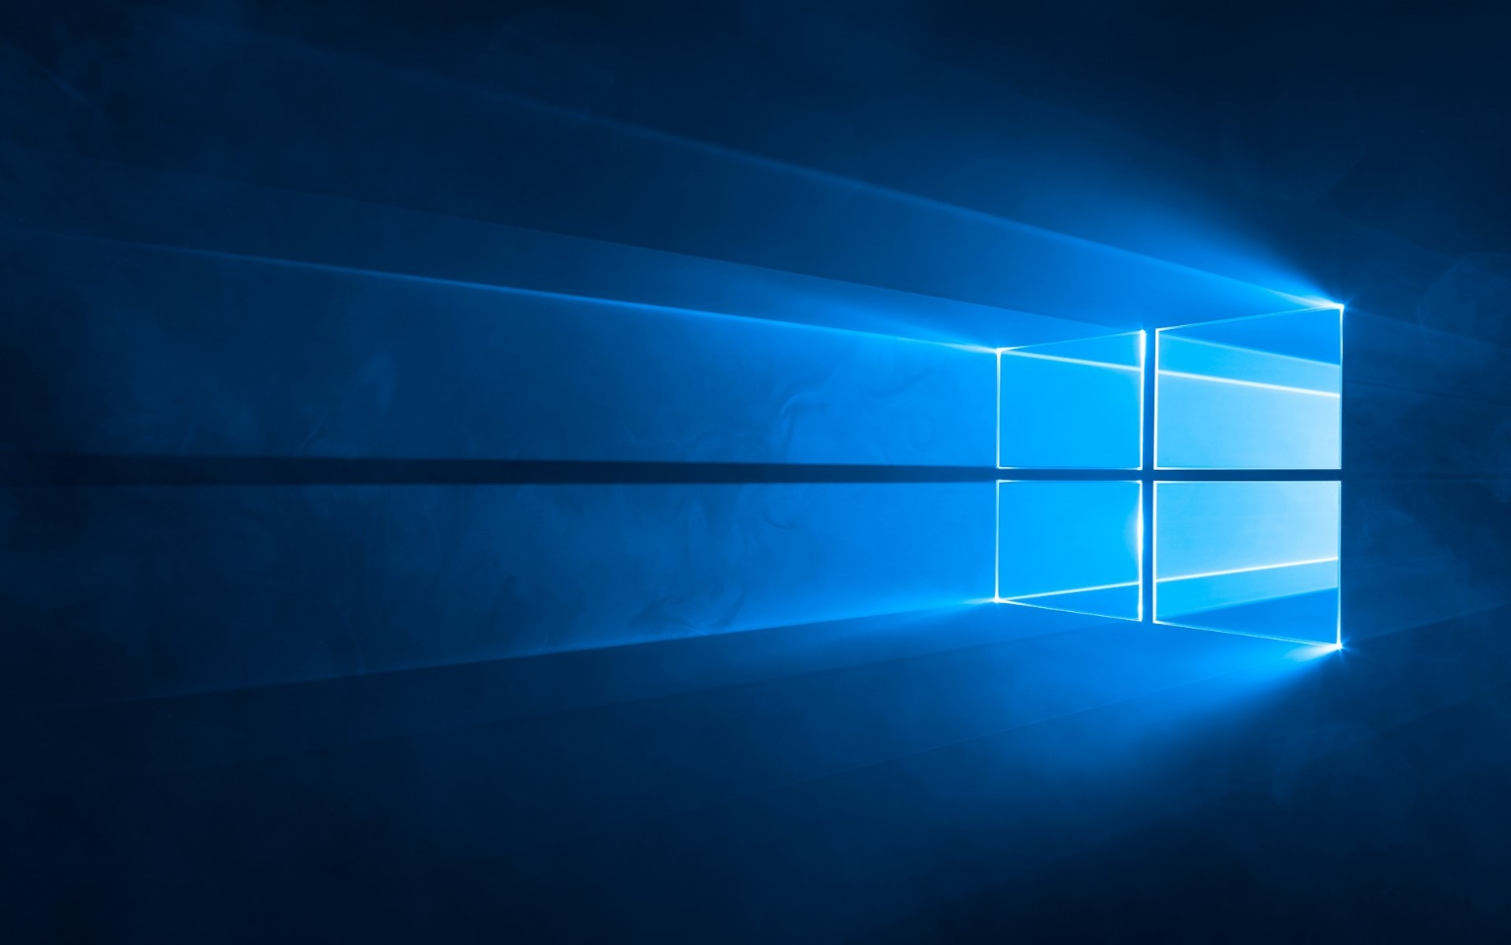
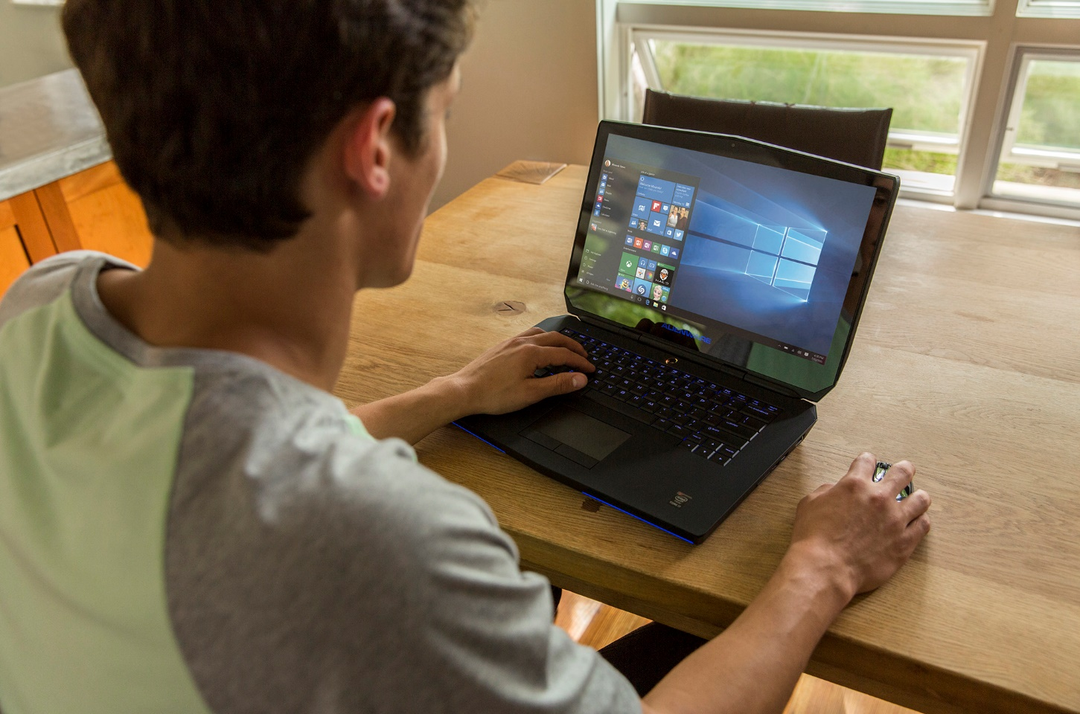
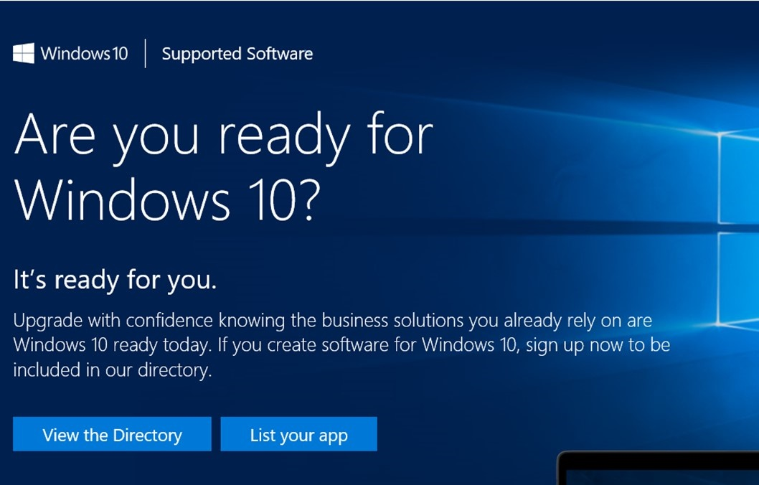




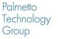
400M*
96%*
145%*
Active devices running Windows 10
Of our enterprise customers in active pilots
Growth trajectory for Windows 10 compared to Windows 7
Windows 10 is on a roll!
“Migration to Windows 10 will be the fastest yet… 50% of enterprises will have started Windows 10 deployments by January 2017.”
“49% of companies plan on upgrading to Windows 10 by 2016.”
“More than half of customers have Windows 10 now and we are in a sprint to get all customers to Win10.”
Carl Mazzanti, Owner, EVP
“I try to get executives to take a Windows Surface, once business leaders try it, they see the value and want to adopt Windows 10.”
Reed Wilson, CEO
* Estimate October 2016 * Source: Windows Disclosures Windows Event NYC, Oct 2016

Slide 7






Customers love Windows 10
Alternative Quotes
“Windows 10 is a game changer for us. We can stay connected with the remote workforce in a way we never were capable of doing before.” -Greg Wooley, Vice President of Flight Operations, ExpressJet Airlines
“Jeppesen is working closely with our customers and Microsoft to deliver innovative solutions like industry leading flight deck pro on Windows 10.” -Thomas Wede, President, Jeppesen – A Boeing Company
“SAP has been working closely with Windows 10 and we are encouraged by the many ways in which Microsoft has taken both developers and end users into consideration when designing the Windows 10 platform. The new capabilities of the platform will enable us to offer our joint customers solutions that further improve productivity.” -Dirk Boessmann, SVP, Mobile Development, SAP
“Using Windows 10 and a stylus, now everyone can draw accurately with Siemens Catchbook™ software.” -Jim Rusk, SVP, Product Engineering Software, Siemens PLM
“Windows 10 and Office 365 really support our employees. We have all the information that’s needed at our customers’ place—and we can help them more efficiently.” – Jos Geeskan, CIO, Wijkracht
“I really like the way that the desktop has returned in Windows 10. It has kept the added functionality such as touch capability that came in with Windows 8, but in a more familiar and comfortable form." -Harrison Anderson, General Manager, The Wash Club
“Windows 10 offers a converged platform across a range of innovative devices that, with applications like NCR’s Sales Advisor, empower sales associates to move from behind the counter to engage customers on their terms.”
Scot DeLancey, Senior Director of Product Management, NCR Retail Solutions
DoD agencies advised to: “…rapidly transition to Microsoft Windows 10 to improve our cyber security posture, lower the cost of IT, and streamline the IT operating environment.”
CIO US Dept. of Defense
“SAP has been working closely with Windows 10. The new capabilities of the platform will enable us to offer our joint customers solutions that further improve productivity.”
Dirk Boessmann, SVP, Mobile Development, SAP
“Windows 10 has changed the game at CLP. Enabling full touch screen ability, quicker deployment times and most importantly the most reliable operating system we’ve ever had."
Kane Steel, Head of Group Planning, Control & IT Operations China Light & Power
“Even teachers that were initially resistant now love the Windows 10 devices because students are more engaged and less disruptive.”
Beth Sommerville, Teacher\Librarian and Technology Integration Specialist, Fairwood Elementary School, Kent School District
“By optimizing the Spark 3D printing platform for Windows 10, we are empowering both Windows users and Microsoft developers to tap the potential of additive manufacturing.”
Samir Hanna, Vice President and General Manager, Consumer and 3DPrinting, Autodesk

Slide 8






What we are hearing from you!
“Windows 10 is our future and a huge opportunity as we build a managed service offering.”
Mark Cabot, Business Dev Director
“My Customer’s business is better with Windows 10, it ensures my value as a trusted advisor.”
Eric Sugar, President
“Windows 10 supports our ‘Workplace as a Service’ offering delivered through our unique Live Workspace solution with great success in Europe.”
Chidu Nachiappan, GM & Global Microsoft Alliance Head, Wipro Limited
“Windows 10 has allowed me to reimagine the offerings I bring to customers, while increasing my profitability.”
Ric Opal, EVP
“Windows 10 is critical for customer security and our business success; our customers stay productive and we can deliver a best in class experience.”
Reed Wilson, CEO
“Customers expect continually declining monthly costs, Windows 10 is how we can achieve this”
Darren Baker, Global Business Dev Director

Slide 9


THANK YOU
for making Windows 10 so successful!
Notes:
Thanks for working hard

Slide 10

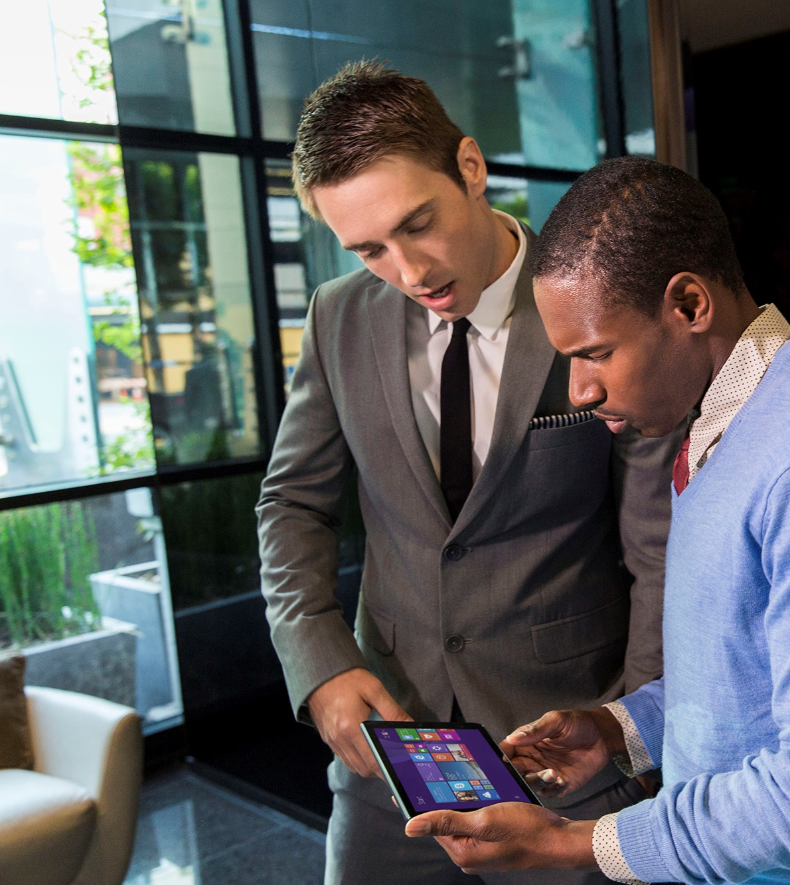
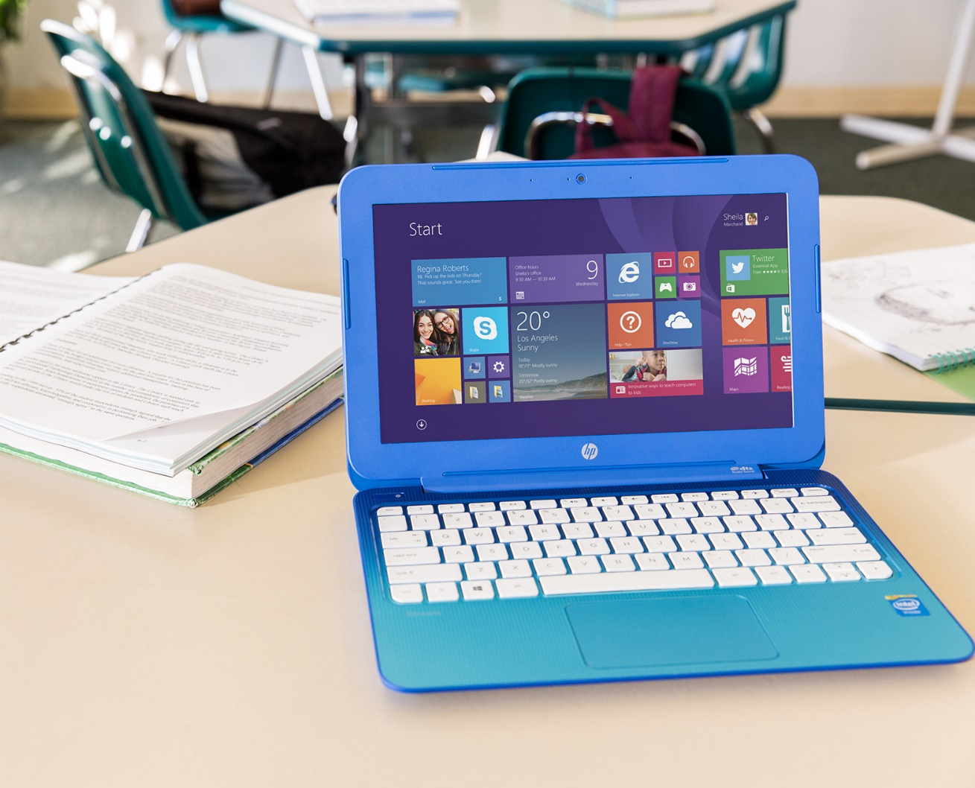
YOUR REVENUE OPPORTUNITY
Notes:
PROFITABILITY Thanks for the introduction. We get it. Windows 10 is well-received by businesses, and it’s really important to enable our Cloud Services Business. Now tell us about the CASH $$!!

Slide 11

This is the year businesses will deploy, act now!
WINDOWS 10 DEPLOYMENT TIME YEARS (FORRESTER)*
YEAR 2
PILOT + Deploy
YEAR 1
TRIAL
TRIAL
BEFORE
4
% INSTALL BASE
PILOT
WINDOWS 10
2
DEPLOY
WINDOWS 10 LAUNCH
July 2016
“Every customer is involved with some Windows 10 POC or pilot, we believe most will begin deploying this Summer.”
Chidu Nachiappan, GM & Global Microsoft Alliance Head, Wipro Limited
“All our customers are either in midst of deployment or considering it. Everyone is in a conversation on Windows 10, at all levels.”
Ric Opal, EVP
*The Total Economic Impact™ Of Microsoft Windows 10, Cost Savings And Business Benefits Enabled By Windows 10, Forrester Research June 2016
Notes:
Forrester has done some recent research on Windows 10 deployments and has determined that Windows 10 is a game-changer! Because of the deployment efficiency engineered into Windows 10, and also because of the positive customer reception to Windows 10, Forrester thinks that the Windows 10 Enterprise OS migration will now take 2 years instead of 4! If you look at the chart on the right, you can see where we are on the deployment wave. We’re right in the middle – at WPC16 – 1 year after launch. With 96% of Enterprises actively considering or already deploying Windows 10 today, you are on the verge of a HUGE migration opportunity! This is going to be a banner year for anyone associated with Windows 10 deployments, and we want to make sure you go get all of this opportunity that you can!

Slide 12

Windows 10 deployment is easy and fast!
DEPLOYMENT TASKS
IT INSTALLATION TIME (LABOR MINUTES) FORRESTER*
WINDOWS 7/8
WINDOWS 10 IN-PLACE UPGRADE*
DATA
DATA – WIPE AND RELOAD
DATA – STAYS IN PLACE
Only the OS is swapped out—data, apps, and device are unchanged
60
BEFORE
APPS
APPS – REINSTALL COMPATIBLE APPS
APPS – ASSESS/PILOT
Automated upgrade (Upgrade Analytics Service—app utilization telemetry)
5
OS
OS – REPLACE
OS – AUTOMATED UPGRADE
WINDOWS 10
DEVICE
DEVICE – NEW DRIVERS
DEVICE – COMPATIBLE
Upgrading to 10 is like a current branch update, minimal change to users
“You can deploy more customers in less time. This allows you to sell higher margin Windows 10 enabled services to more customers.”
Eric Sugar, President
UI
UI – RETRAINING
UI – FAMILIAR
*Note “In Place Upgrade” does not provide full new capabilities/security of Windows 10 but covers earlier OS capabilities
**The Total Economic Impact™ Of Microsoft Windows 10, Cost Savings And Business Benefits Enabled By Windows 10, Forrester Research June 2016
Notes:
Windows deployments used to be difficult and time-consuming. There was a need to migrate data carefully so nothing was lost or mis-placed. There was a need to carefully assess every application and often times drive application updates/configurations. The OS installation itself often required a full “wipe and reload”. Device-drivers had issues that need to be sorted out and even the user-interface itself often required re-training of employees so they could to their jobs. With Windows 10, that story changes quite dramatically!
With Windows 10, data migration isn’t an issue because it stays in-place and is intergrated seamlessly with Windows 10. Applications that work on Windows 7 or Windows 8 will almost always work well in Windows 10, too, and this can be easily confirmed in a POC or Pilot phase of deployment. The OS installation itself is highly automated, using just 1/10th of the previously required labor minutes - because you don’t need someone sitting there during the installation. Device-Drivers are also compatible with Windows 10 and the user-interface is one that is familiar and easy for customers to use. In short, Windows 10 is an easy, efficient and effective deployment for you to make with your customers.
Now… You may be asking yourself how you still make $ in this new Windows 10 deployment scenario, with labor minutes being reduced. Well, that question is easily answered. You re-focus the labor minutes of your staff in other directions. First, you focus your staff on deployments with MORE customers as it takes less time. Second, you use their extra time to do more Cross-Selling and Up-Selling – hopefully to MORE customers, thus growing your long-term annuity income stream.
Let’s walk through this opportunity in a bit more detail in the next slide…

Slide 13


Windows 10 is your foundation for services revenue
PARTNER MANAGED RECURRING REVENUE IS PRIMARY GROWTH DRIVER
IP AND NEW INDUSTRY/ FUNCTION SCENARIOS PROJECTS
Windows 10 momentum/ customer interest
Device refresh
OFFICE 365, EMS, AZURE AD, IMPLEMENTATION AND RECURRING REVENUE
30–40% project margin
40–60% IP margin
MANAGED SERVICE (DESKTOP+) MONTHLY RECURRING REVENUE
30–40% margin
NEW WINDOWS PROJECTS, SECURITY, LIFECYCLE MANAGEMENT
DEVICES & ACCESSORIES HW/SW RESALE
40–50% margin
Windows 10 momentum/ customer interest
POC, PILOT, SCCM PREP & DEPLOYMENT PROJECTS
30–40% margin
“Windows 10 unlocks cloud profitability. Without Windows 10 we won’t have a successful cloud business”
CHRIS HERTZ – FOUNDER
5–15% margin
20–30% margin bundled as monthly managed service
20–30% margin
PARTNER REVENUE BUILT ON WINDOWS 10
Notes:
As we said before, Windows 10 has great customer momentum. 96% of our enterprise customers are actively looking at Windows 10 deployments! On top of that, Windows 10 is the very foundation for your services business. In talking to many top partners from around the globe, it was proven that the strength of their services business depends on Windows, and Windows 10 in particular. WITH Windows, our partners make more $. Plain and simple. While partners CAN manage other operating systems, those “mixed OS” environments cost more $ to manage, and there is inherently less cross-sell and up-sell opportunity for partners.
So how do customers enter this “Windows 10 Revenue Ramp”? 2 main ways. The first, we have already spoken about. There has been amazing press coverage for Windows 10 and customers love it. 350 million active devices are running Windows 10 and that number is still climbing quickly each day! The other main customer entry-point for the Windows 10 deployment is around Device Refresh. Windows 10 Pro devices are better and a better value - than ever before. And there are a LOT of devices that are coming-up on their 3 year refresh period from when they were sold-in for Windows XP End of Support in 2013/2014. Every one of the Notebooks, Tablets, and 2-in-1s that were sold in 2013 or 2014 are due for a refresh and this is an excellent place to start a Windows 10 deployment conversation.
Now… Windows 10 Deployments and Devices may be the start of the conversation with your customers but it’s really just the start. With Windows trusted boot, Device Guard, BitLocker, Credential Guard, Windows Information Protection, and now Windows Defender Advanced Threat Protection, you can sell Windows Security Services as a high-value (and high margin) service for your customers that will ensure they, their data, and their customers’ data remains secure.
And don’t forget – with ongoing releases of Windows 10 features and product updates, there needs to be ongoing testing with a company’s applications and internal systems to ensure there are no compatibility issues. This is another ongoing, high-margin service that you can provide to your customers.
And for those of you that have a strong Outsourced IT business, that business just gets more profitable for you as customers move to Windows 10 because management becomes more efficient with Azure AD integration and fewer support issues related to the user interface or application/ driver compatibility issues. So your costs go down with Windows 10 while your revenues don’t need to. Of course, if you are locked into contracts where your revenues MUST go down on a periodic basis, then Windows 10 deployment presents a “reset” point for you while also granting cost efficiencies. Any almost any scenario, you WIN when Windows 10 gets deployed!
Of course, our other Microsoft Cloud products: O365, EMS, Azure AD, and CRM Online, all work BEST on a Windows 10 operating system. Windows 10 enables touch features and APIs that allow for the best, fullest functionality of our Microsoft products. When we design our products, we design for OUR other products first to ensure best compatibility. This shows when customers are aligned across a Microsoft product stack. Thus, when you have sold or deployed Windows 10 to your customers, you have a CLEAR opportunity to sell and manage these other Microsoft products and earn additional, recurring revenues at a high margin.
Perhaps most importantly, lets not forget about your own “Special Sauce” that you bring to the table for your customers. Whether it’s an industry-focused application that you have designed or a software “layer” that you have developed to better serve your customers across their various devices and software, many of you bring that extra ingredient to the customer which helps to ensure customer loyalty while returning high margins for you. This is something we strongly encourage you to continue to provide. And please know that Microsoft is dedicated to providing you with the tools and support you need to make sure that your integration – On TOP of the Windows 10 foundation and WITH our other Microsoft products – is brilliant.

Slide 14
Strong opportunities for all types of partners
SYSTEM INTEGRATION
MANAGED CLOUD SERVICES
SALES & LICENSING REVENUE
Deployment Projects, LTSB
Application Testing as a Service
Application Migration (App Store)
Security Project Implementation
Device Margins
Windows Enterprise E3 and E5
O365
EMS with Azure AD, MDM
CRM Online
Application Management (Azure)
Bundled Devices
SW Licensing Margins (traditional EA)
Cloud Solution Provider Incentives
Device Margins (Surface Book, Premium Devices, and New Form Factors)
SECURITY SERVICES
OUTSOURCED IT SERVICES
ISV/IP REVENUE
Advanced Threat Protection
Windows Information Protection
Passport for Work
Device Guard
Multi-Factor Authentication
Helpdesk/Support Services
Device Management
Application Development (Azure)
ISV Software Updates and Extensions leveraging Touch, Mobility, Security…
Templates and Integrations
Notes:
Whether you are a Device Seller, a System Integrator focused on helping customers deploy Windows 10, a Managed Service provider with an emphasis on the cloud, an LSP focused on agreement renewals, a Security Services partner working to ensure the best protection for your customers, an Outsourced IT partner, or an ISV, you all have something in common for the next year. Windows 10 deployments are going to be BIG. As they happen, as YOU drive to make them happen, you have a great opportunity to better serve your customers. Not just in your field of comfort, but also in additional service areas. Because Windows 10 deployments require less labor minutes than in the past, you can dedicate fewer resources to this effort while transitioning more resources to the services Cross-Sell and Up-Sell motion – Gaining you more of those 40% margin, recurring revenue streams!

Slide 15


HOW TO TALK TO CUSTOMERS ABOUT WINDOWS 10
Notes:
Let’s recap for a moment…
People LIKE Windows 10!
Big Deployment / Migration Opportunity in FY17, year #2 of Windows 10!
There is opportunity for ALL types of partners to make more $ with Windows as the foundation for an IT Services business.
Now let’s move on to how we talk to our customers about Windows 10.

Slide 16






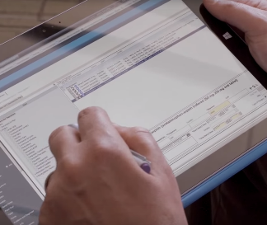



DIGITAL TRANSFORMATION
Is everywhere
Notes:
Complete slide talk track below.
Key points to land
The current technological transformation cuts across all industries and companies big and small. Even the most entrenched industries are being disrupted by digital transformation.
Some of the most disruptive companies we have seen arise over the last few years have been riding this trend.
These companies are using technology to meet the demand for more personal experiences for customers.
Established companies are creating more personal experiences – leading the charge of their digital transformation, in attempts of beating digital disruptors to the punch
Talk track
We have seen a wave of digital transformation happening in business over the last few years. This transformation cuts across all industries and companies big and small.
Some of the most disruptive companies we have seen arise over the last few years have been riding this trend. These companies are using technology to meet the demand for more personal experiences for customers.
Companies like: Uber delivering the type of car when and where you need it making it reliable and seamless – and disrupting the 100+ year old taxi industry.
AirBnB, taking the middle-man out of lodging and really allowing you to find a perfect, and personal location.
Even the most entrenched industries are being disrupted by digital transformation.
(Click)
But digital transformation is not just on the minds of startups.
We see companies from established travel, hospitality, banking, healthcare, retail, and a host of others working hard to digitally transform themselves. They are not just worried about non-traditional competitors or new business models invading their space—they are using these more personal experiences to succeed.
In a world where digital technology is evolving and often disrupting any industry you can think of, building and maintaining personalized customer relationships has become more important than ever. That’s why CMOs and brand leaders need to look beyond the traditional marketing tactics of yesterday and embrace new, immersive and unexpected ways of delivering powerful experiences for their customers.
Virgin Atlantic did just that with the creation of Ida, an immersive digital adventure which features specially created content that takes viewers on a guided tour through a virtual Upper Class experience, from check-in to boarding — all shown on a compact mobile device that can meet the audience where they are.
Ida allows Virgin Atlantic to seamlessly and flexibly share this experience across multiple devices, while capturing more insightful intelligence about their customers’ wants and needs.
Whether at large trade events or sending field agents for small-scale client meetings, they have a digital experience to share that isn’t the focal point, but rather a way to create curiosity and spark conversations.
**************************************************************************************************
** Talk track from here is based on Virgin Atlantic case study. Other case study links are at the end of the slide notes. Feel free to replace with a different case study that is more appropriate for your customer. **
**************************************************************************************************
Virgin Atlantic, source: http://blogs.microsoft.com/business-matters/2015/11/10/virgin-atlantic-brings-its-customer-experience-to-life-using-windows-10/
TGIF, source: http://news.microsoft.com/2015/01/12/tgi-fridays-partners-with-microsoft-on-tablets-to-streamline-orders-improve-customers-visits/
SunGard, https://www.sungard.com/company/newsroom/press-releases/2015/investor-financial-planning-apps-2015
Sheraton Hotels and Resorts, https://customers.microsoft.com/Pages/CustomerStory.aspx?recid=6799
University of Pittsburgh Medical Center (UPMC), https://customers.microsoft.com/Pages/CustomerStory.aspx?recid=3094
**************************************************************************************************

Slide 17


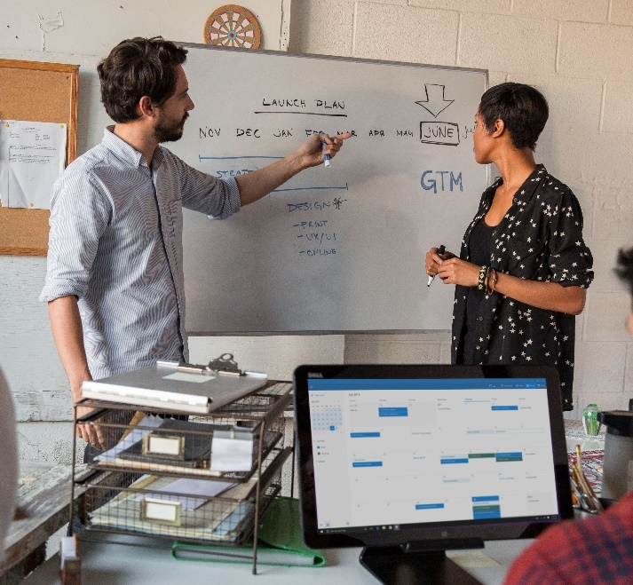

Customers told us…
I’m worried about security threats and managing the risk to my business
My employees need to be productive on every device they use
Old PC Tech, infrastructure and processes drive up costs and slow business agility
We need to capitalize on new business opportunities quickly
We listened…

Slide 18
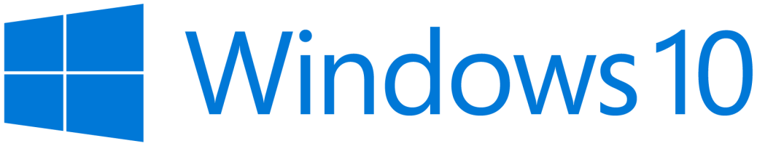
DESIGNED FOR DIGITAL TRANSFORMATION
Safer and more secure
More productive
More personal
Powerful, modern devices
Notes:
[Complete slide talk track below.]
Key points to land
Security is key to a successful digital transformation. We’ve made great investments in Security to protect your company from modern security threats, Windows is THE most trusted platform for businesses
We have designed Windows to help you lower TCO and get rid of a lot of the costly processes that you were using before.
Windows exceeds employee expectations for more personal computing and productivity.
That is delivered on with the versatile devices you already own, AND lighting up the newest and most innovative devices out there.
Talk track
These needs have guided our investments in Windows 10.
We could talk for hours about security alone, where we are working hard to deliver new ways to protect your company from modern security threats - making Windows THE most trusted platform for businesses.
We have also designed Windows to help you lower TCO by making your IT department more productive. We want to help you reduce the amount you are investing in maintaining the status quo with old infrastructure and processes, so you have more to invest in digital transformation.
And we are focused on the user, meeting and exceeding their productivity needs—and delivering on their expectations for more personal computing.
We are delivering this on with the devices you already own, AND lighting up the newest and most innovative devices out there.

Slide 19

Safer and more secure
REPLACE PASSWORDS, PROTECT IDENTITIES
ONLY RUN SOFTWARE
YOU TRUST
PROTECT SENSITIVE CORPORATE
DATA
DETECT COMPROMISED DEVICES QUICKLY
WINDOWS HELLO
MICROSOFT PASSPORT
COMPANION DEVICE FRAMEWORK
CREDENTIAL GUARD
SECURE BOOT
DEVICE GUARD
WINDOWS DEFENDER
WINDOWS INFORMATION PROTECTION
WINDOWS DEFENDER ADVANCED THREAT PROTECTION
Notes:
[Complete slide talk track below.]
Key points to land
Passwords need to be replaced with something more secure, but we don’t stop there, we drive a series of innovations that will both protect identities and delight users.
Running only the software you trust is a key to protecting your devices. Windows does this to help eliminate malware.
EDP products against accidental data leakage.
Barcelona uses micro-virtualization to secure the browsing sessions. (Coming in 2017)
Windows Defender ATP provides post breach protection to quickly detect suspicious behavior.
Replace Passwords & Protect corporate identities]
It starts with replacing passwords and protecting corporate identities.
Windows Hello and Microsoft Passport are the most personal and secure way to access Windows devices and services and today. They provide enterprise grade security with fingerprint, facial, and iris recognition.
This summer we will make good on the promise to enable you to use you phone to remotely unlock your Windows 10 PC’s, we’ll start with Windows Phone and Android this year and follow up with iOS next year. Adding a second factor of authentication just got a lot easier and cost effective for your organization.
But phones are just one type of device you want to use for authentication. So we’re introducing the Microsoft Passport companion device framework. This means that hardware vendors can more easily innovate and create devices of all types In addition, this framework allows you to extend multi-factor auth to sites and services on the web!
These devices will range from traditional ID cards or smart cards, to wearables, or even IoT devices. Each of these devices can offer the same enterprise grade security that you’re used to today. This means you can choose the solution right for you—including defense, financial, retail, and health care—just to name a few.
You will see devices from partners like Yubico, HID, and others. One interesting device is the Nymi band. The Nymi band can monitor your heart rate to uniquely identify you, and log you in when you get close to your device.
In addition to authentication, we continue to harden the OS to protect corporate identities (certificates, tokens, tickets, etc.). This includes using hardware based virtualization to isolate and protect logins from attacks, heading off an entire category of attacks.
This means that, if an employee falls victim to an attack, Windows 10 has technologies, such as Credential Guard, to help contain the breach and prevent the attacker from moving beyond that device.
In the past, attackers could spread across your network from one device using a technique known as “Pass the Hash.” With Windows 10, these attacks (in their current form) no longer work.
[Only run software you trust]
We have to rethink our approach to running only software we trust. Today we run anti-malware programs and try to look for malware signatures. While important, we need to do more. In one study almost half of the PCs breached lacked any currently detectable malware on them. Hackers often compile specific code for specific attacks and they go after the weak like, the users, to get them to install it.
Windows protects the applications you run so you can ensure only software your IT department has signed is trusted and runs with a technology called Device Guard. Even if an employee accidently downloads dangerous software your devices can be protected against it.
[Protect enterprise data against leaks, theft, or accidental disclosure.]
We are also making advances to help protect sensitive intellectual property.
With the increase of employee-owned devices in the enterprise, there’s also an increasing risk of accidental data disclosure through apps and services that are outside of the enterprise’s control like email, social media, and the public cloud.
Many of the existing solutions try to address this issue by requiring employees to switch between personal and work containers and apps, which can lead to a less than optimal user experience. Enterprise data protection (EDP) offers a better user experience, while helping to better separate and protect enterprise apps and data against accidental disclosure risks across both company and personal devices, without requiring changes in environments or apps. Additionally, EDP when used with Rights Management Services (RMS), can help to protect your enterprise data by persisting the protection even when your data roams or is shared.
[Browse Securely]
Browsing securely is an area that many companies worry about. This is an area where we are doing some very innovative things.
In 2017, we will introduce a way to move Edge browser sessions within a micro-virtualized environment. Similar to how Credential Guard uses hardware based security today, this will isolate whatever is running in the browser from your corporate data, and protect your devices.
If a user’s session is attacked and the attacker is able to drop any type of malware or gain any kind of foothold on the device, it all disappears when the browser session is closed.
We are very excited about the level of security this can bring and will have more information to share as we progress and get closer to 2017.
[Detect suspicious behavior quickly]
Even with all of the defenses Windows 10 introduces it’s hard to keep every intruder out. Sometimes they find and exploit vulnerabilities that aren’t known, or more often they find ways around the best defenses with social engineering and attacking the user. Regardless of how they get in, if you don’t know they are there they can do real damage. While we will continue to invest heavily in building stronger defenses you should also use a mindset that assumes breach to provide additional protections.
Everything we have talked about so far is about working to better keep the users out of your devices and network. To help protect our enterprise customers, we are developing Windows Defender Advanced Threat Protection, a new service that will help enterprises to detect, investigate, and respond to advanced attacks on your network and devices.
Let’s talk more about Windows Defender ATP… CLICK…

Slide 20




Windows Defender Advanced Threat Protection Helps enterprise customers detect, investigate and respond to advanced attacks and data breaches
POST BREACH DETECTION FOR ACTIVE ATTACKS
EASILY INVESTIGATE AND EXPLORE BREACHES
SELF HUNTING ACROSS PROTECTED ASSETS
BUILT IN THREAT INTELLIGENCE KNOWLEDGE BASE

Slide 21
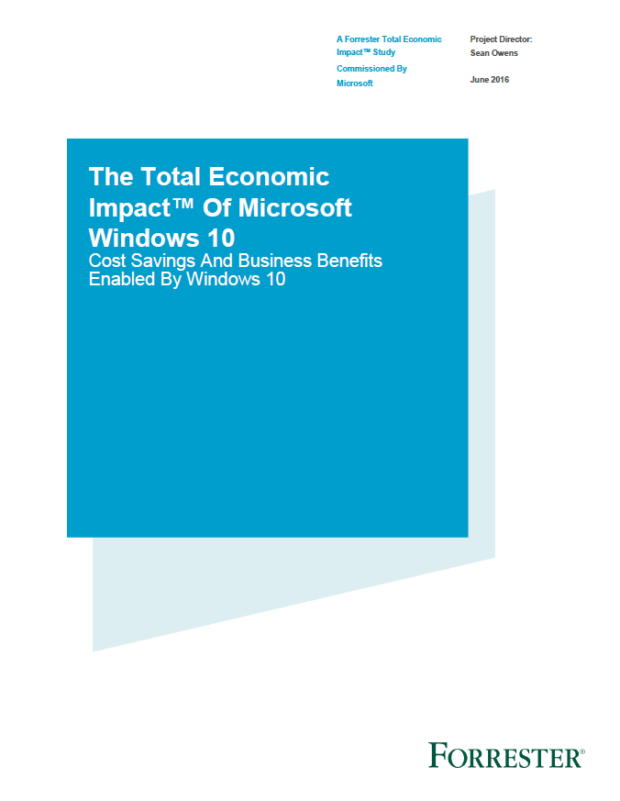
Windows 10 deployment pays for itself in 13 months
Forrester Consulting Total Economic Impact findings:
Improved productivity, mobile workers gain 25% of time previously unavailable for work
15% savings in IT Desktop Management
33% reduction in security issues and time to resolve
$710K in security issue remediation savings
$403 per user 3 year NPV
188% ROI
13 month payback
Source: “The Total Economic Impact^{(TM)} Of Windows 10, a commissioned study conducted by Forrester Consulting on behalf of Microsoft, June 2016. Results are for a risk adjusted composite organization based on customer interviews.
Notes:
Customers want to know the financials of Windows 10, and Forrester has analyzed the Total Economic Impact, we will make this report available for you to use with your customers.
To start with, most customers already are licensed to run Windows 10, so if they don’t deploy, they are not using something very valuable that they have already paid for.
We’ve talked about how the deployment costs are much lower than with prior versions, so now lets focus on three of the key economic benefits highlighted in this report:
15 % savings in IT desktop Management – “Windows 10 requires less IT administration time to install, manage, and support, with easy-to-use features and more self-service functions.”
33% reduction in Security issues and time to resolve – “New features such as Credential Guard and Device Guard and improvements in existing features (such as BitLocker), security events requiring IT remediation are reduced or avoided.”
25% reduction in employee time previously unavailable for work especially mobile workers, “enabling them to get more done more quickly wherever they may be.“
Additional saving in Application Provisioning, Reduced or eliminated 3rd party licensing, faster wake and boot time
With these savings against a lower deployment cost in less than half the time, they calculated a positive NPV of $403 per user over 3 years, a dramatic 188% ROI, and payback in only 13 Months.
Your customers can’t afford NOT to deploy the Windows 10 system that they already own!
To help your customer understand how these savings would apply to their situation we have developed a TCO calculator for you to use with them for economic justification

Slide 22
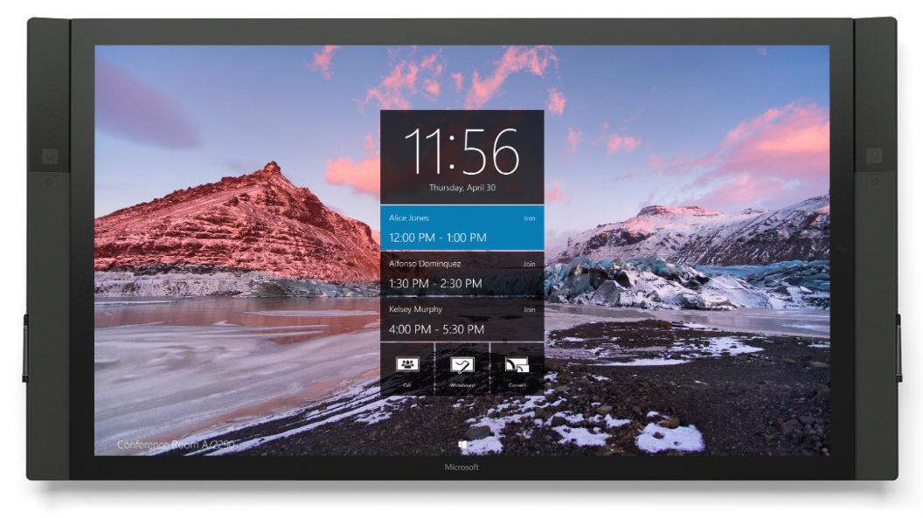
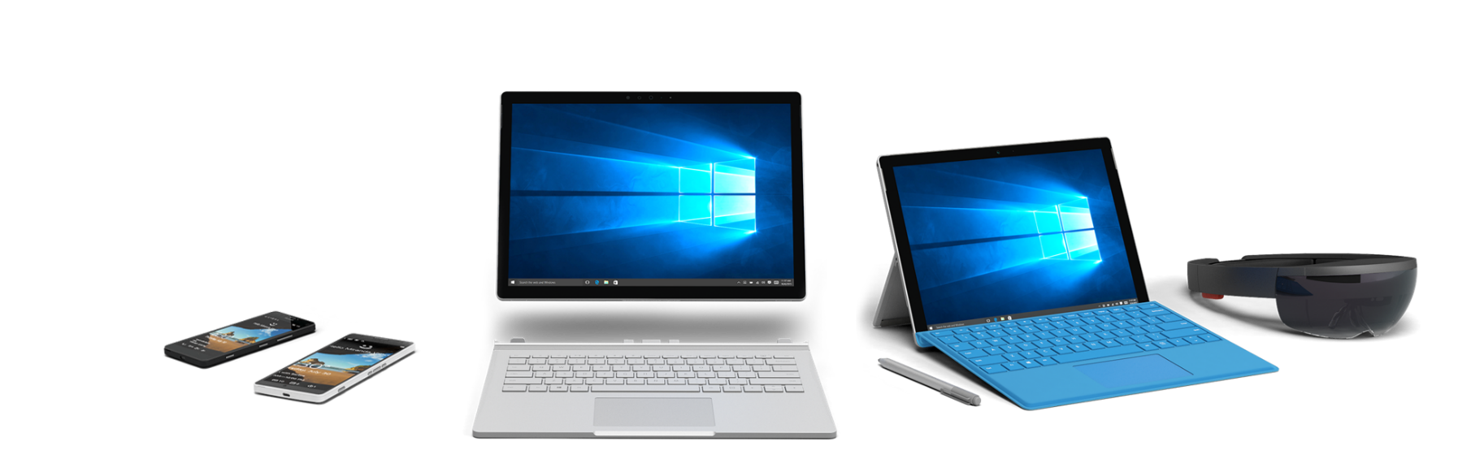
Powerful, modern devices
Quality Craftsmanship & Design
Mobility of Experience
Breakthrough Categories
Versatile Form Factors
Notes:
TALK TRACK:
Earlier I talked about how we’re bringing together our R&D into one 1st party devices engineering team, so that the team which has built Surface, Surface Hub and Hololens will also be the team that builds our next generation devices. This is critical to ensure we are consistent in our investments to design business-class devices that support more human centric experiences.
Our 1st party devices engineering team are devoted to building quality devices,
which breakthrough categories,
empower more versatile experiences
And that seamlessly integrate with Windows to allow people to be productive.
We are seeing fantastic momentum in our Surface business – where revenue increased by 61% in Q3 (FY16) – and we are generating excitement by innovating in new categories like HoloLens and Surface Hub and you can count on us to continue innovating in emerging categories of devices.
<OPTIONAL LONGER TALK TRACK>
As a company, one of our bold ambitions is to deliver more personal computing. In order to have more personal computing, you have to have hardware that supports more human-centric experiences. We are committed to designing business devices – from Lumia to Surface & Surface Hub, to HoloLens – that are the most seamlessly integrated with Windows. They put people in the driver’s seat and can be engaged with multiple senses, they push the envelope on what versatility means by easily adapting to be more than a smartphone and more than a tablet.
Real business transformation will happen because devices are becoming more personal, more human. Interacting with technology should be as natural as interacting with people – using voice, pen, gestures and even gaze for the right interaction, in the right way, at the right time. With form factors of all sizes that move and adapt to your needs – whether you are on the go, in your lap, or at your desk – moving from individual work to collaborative work and back again.
Just like you - the businesses who use Microsoft, we obsess over every detail. We strive to find ways that technology can make it easier to get work done, to innovate on the small change that’ll make a big difference. A minute or two saved here and there adds up to hours that can be spent doing what actually matters – doing great things.

Slide 23
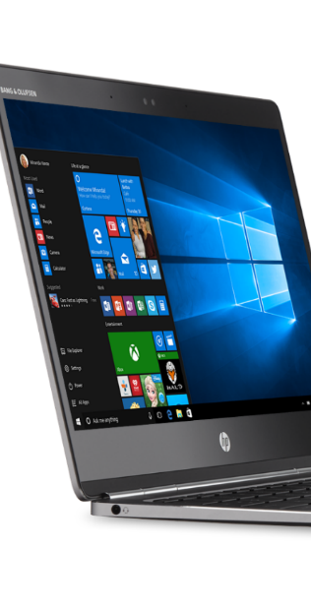
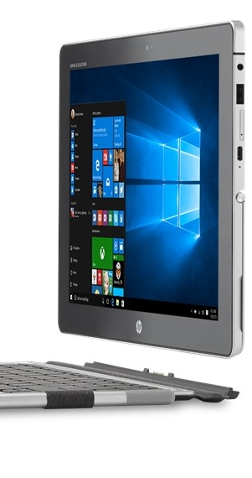
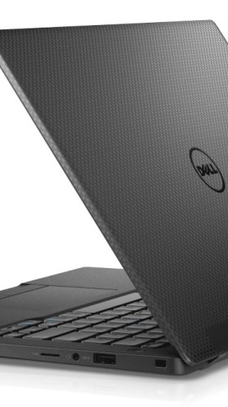
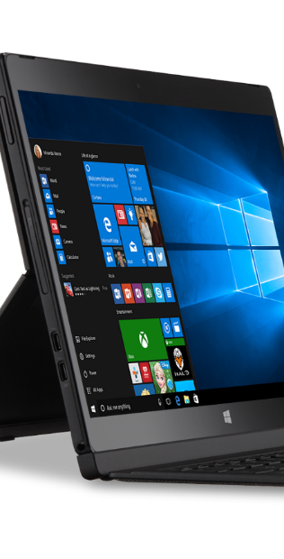
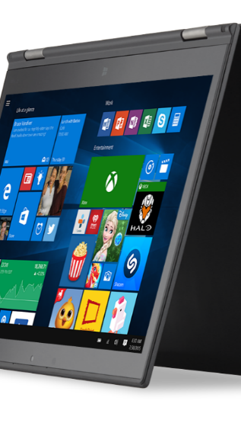
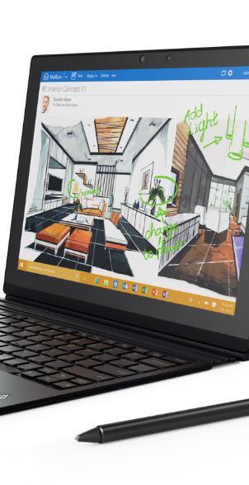
Accelerate the PC Refresh and attach services Windows 10 ROCKS on new devices!
ENHANCED SECURITY – TPM 2.0 processor, Biometric support
INSTANT ACCESS – Windows Hello* and Microsoft Passport multifactor credentials require modern hardware
MOBILITY OF PC/TABLET 2-n-1 – Seamless keyboard connection transition with Continuum
TOUCH PRODUCTIVITY – Windows and modern aps are designed for touch screen display and stylus (write draw annotate on screen)
SPEECH PRODUCTIVITY – Cortana Personal Assistant uses array microphones to respond to your commands
Over 400 million devices that are over 4 years old! (Intel)
Cortana available in select markets at launch; experience may vary by region and device.
Windows Hello requires specialized hardware, including fingerprint reader, illuminated IR sensor or other biometric sensors.
HP EliteBook Folio
HP Elite X2 1012
Dell Latitude 13 7000
Dell Latitude 12 7000 2in1
Lenovo X1 Yoga
Lenovo X1 Tablet
Notes:
Windows 10 devices can protect you from modern security threats with new hardware enabled security features, like TPM 2.0, Processor based virtualization extensions, and biometric support that provide protection Windows 7 and 8/8.1 devices can’t provide today.
Windows Hello* and Microsoft Passport provide secure and easy to deploy multifactor credentials that requires specialized hardware, including illuminated IR sensor or other biometric sensors.
Personal assistant Cortana* helps you get things done. Array microphones enable you to speak directly with Cortana.
Be productive with or without a keyboard with Continuum. A new feature that allows you to transition easily from touch and stylus to keyboard and mouse with new 2-n-1 devices.
Use touch naturally to go beyond how you use your smartphone—for scrolling, sizing, navigating, and more.
Write, draw, and annotate documents naturally using a stylus.

Slide 24
Develop your Windows 10 Enterprise deployment 2-min pitch
Windows 10 is the best received Windows Operating System ever. 350M devices. 96% of enterprises are actively testing. A clear winner.
It’s great for your organization now for 4 reasons: IT’S EASY, IT’S SECURE, PEOPLE LOVE IT, IT SAVES YOU MONEY
1
2
4
It’s much easier and faster to deploy than you expect
It’s safer against modern threats
3
It’s easier and cheaper to manage
Customers love its interface, mobility, and modern devices
Windows 10 Enterprise is EASY, SECURE, PEOPLE LOVE IT, SAVES YOU MONEY. We can get started right away!
Notes:
Windows 10 is the best received Windows Operating System ever. 350M devices. 96% of enterprises are actively testing. Windows 10 is a clear winner. But those are just stats, let’s talk about why Windows 10 is great for your organization now.
4 reasons: IT’S EASY, IT’S SECURE, PEOPLE LOVE IT, IT SAVES YOU MONEY
IT’S MUCH EASIER AND FASTER TO DEPLOY THAN YOU EXPECT
With In-Place Upgrade nothing moves – just the OS is swapped out
It’s compatible with what works on Windows 7/8 – no pre-app compat testing, just pilot and go
Less than 1/10th the IT time to deploy – more like a patch than an OS update
Highly consumerized, users can launch the upgrade themselves, or IT can do it remotely
Most SMB deployments can be completed in a few weeks, large enterprises will move the bulk over this year
IT’S SAFER AGAINST MODERN THREATS
Data theft is now a big business with unprecedented threats, and consequences
Windows 10 makes security better and easier for users: replacing passwords with Windows Hello and Multi-Factor Authentication to manage identity on the device and online
Windows Information Protection, Trusted Boot, Bitlocker, and malware defenses are built into the core
Windows Defender ATP detects breaches and recommends proactive responses against hackers
CUSTOMERS LOVE ITS INTERFACE, MOBILITY, AND MODERN DEVICES
Immediately familiar and intuitive – no retraining (it’s what they are using at home)
Build to work with cloud mobility (O365, OneDrive, Azure AD) increasing productivity
Touchscreen and new device form factors that let you work from anywhere
It’s the fastest adopted OS ever, growing 145% faster than Windows 7
IT’S EASIER AND CHEAPER TO MANAGE
We have seen that standardizing on Windows 10 Enterprise will lower management cost by 35%
Forrester estimates 15% savings in IT desktop management and a 33% reduction in security issues and time to resolve
Frequent updates means latest features and security and no additional cost - the end of big OS upgrades
Delivered as one service we can provide and manage for you (Cloud Solution Provider packaged with O365, EMS, Azure AD)
Deploy Windows 10 Enterprise now because it’s EASY, SECURE, PEOPLE LOVE IT, SAVES YOU MONEY. We can get started today.

Slide 25


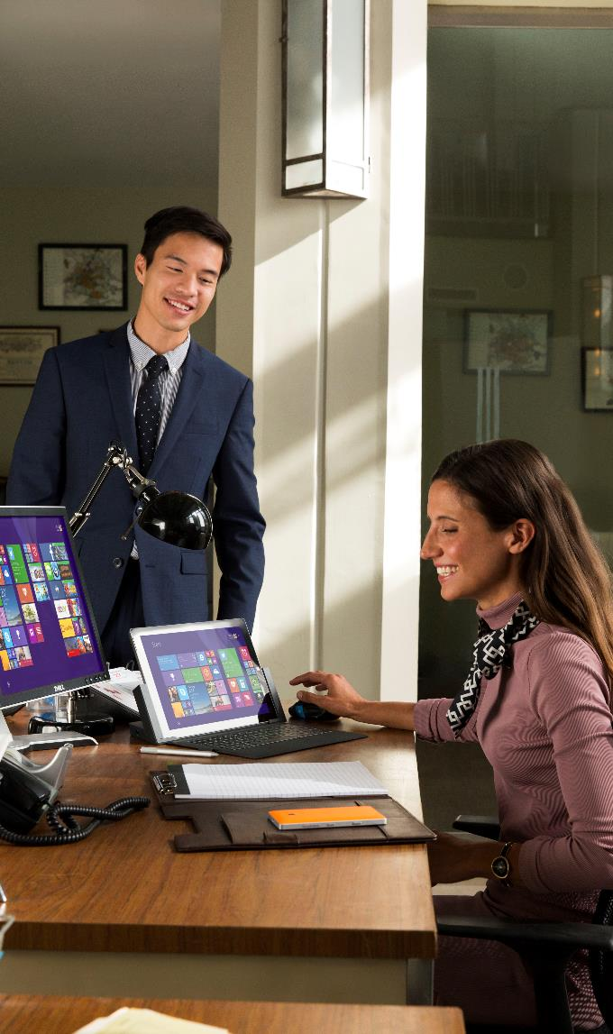
NEW OFFER AND LICENSING OPTIONS

Slide 26


Empowering Employees
Secure Productive Enterprise

Slide 27

Empower your employees by creating a secure productive enterprise
Trust
Protect your organization, data and people
Collaboration
Create a productive workplace to embrace diverse workstyles
Mobility
Enable your people to get things done anywhere
Intelligence
Provide insights to drive better business decisions
Notes:
Our unique approach

Slide 28

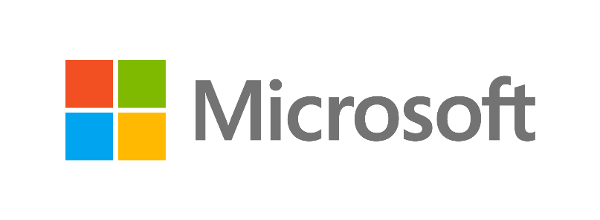
Secure Productive Enterprise
Delivered through best in class cloud services
Office 365
Enterprise Mobility + Security
Windows 10 Enterprise
Notes:
Our unique approach

Slide 29

INTRODUCING:
WINDOWS 10 ENTERPRISE E3 FOR CSP

Slide 30
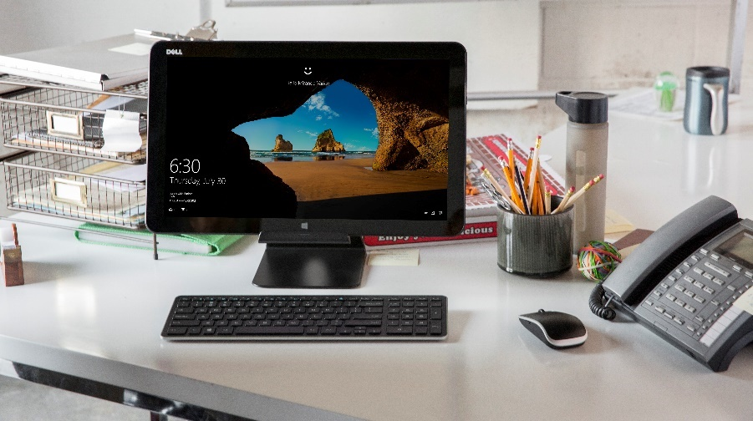
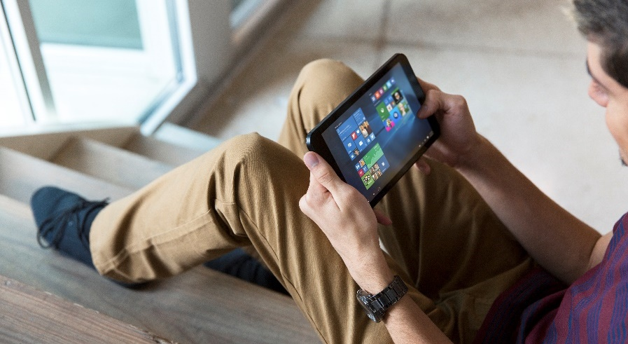

Windows Enterprise Subscription, Perfect for SMB
“Get enterprise-grade security and control for your small business… without the enterprise-grade price”
THE MOST SECURE EDITION OF WINDOWS
MANAGED BY YOUR TRUSTED PARTNER
WITH A SMALL BUSINESS PRICE OF $7
Secure your data and devices
Secure your user identities
Secure your business
Your IT managed by experts
Your own customized device strategy
You manage your business
With per user per month pricing
With pay-as-you-go subscription
With flexibility to scale as you grow
EASY ADD-ON TO EMS OR OFFICE 365—OR AS A STAND-ALONE SERVICE
Notes:
Windows 10 empowers people of action to do great things, providing:
A familiar and productive experience from anywhere, across your devices
Light-touch management that scales with your needs
Enterprise-grade security to guard your business and give you peace of mind, and
A wide range of innovative and affordable devices to power your business
Windows 10 Enterprise Subscription provides additional security and management options to support the specialized needs of businesses that process sensitive data, operate in regulated industries with strict compliance requirements, develop software in-house and/or are publicly traded or aspiring to issue an IPO.
If you fall into any of these categories, Windows 10 Enterprise edition benefits your business in 3 key ways:
Increased security: help make sure sensitive data, identities, and devices are protected from cybersecurity threats, give employees the freedom and flexibility to access sensitive data on a variety of devices, and help ensure employees see highly-sensitive data only on a need-to-know basis
Simplified licensing: lower your up-front costs, eliminate the need for time-consuming device counting and audits, and make it easier to stay compliant with a subscription-based, per-user licensing model.
Partner-managed IT: offload the task of configuring and managing devices to a partner experienced in Windows and cloud deployments. Your partner will also help you develop a device security and management strategy that uses the unique features of Windows 10 Enterprise Subscription to meet the specific needs of your business. This makes Windows Enterprise Subscription ideal for SMBs who have limited or no in-house IT. You’ll also be able to view subscriptions and usage for Windows Enterprise, as well as any other Microsoft cloud services you may have purchased, in your partner portal.
Examples of small and medium-size businesses that could benefit from the Windows 10 Enterprise edition include:
Healthcare:
Physician’s practice
Physical therapy clinic
Biotech startup
Retail:
Local drugstore chain
Financial/Professional Services:
Investment advisory firm
Legal firm
Insurance agency
Manufacturing:
Small food manufacturing company

Slide 31
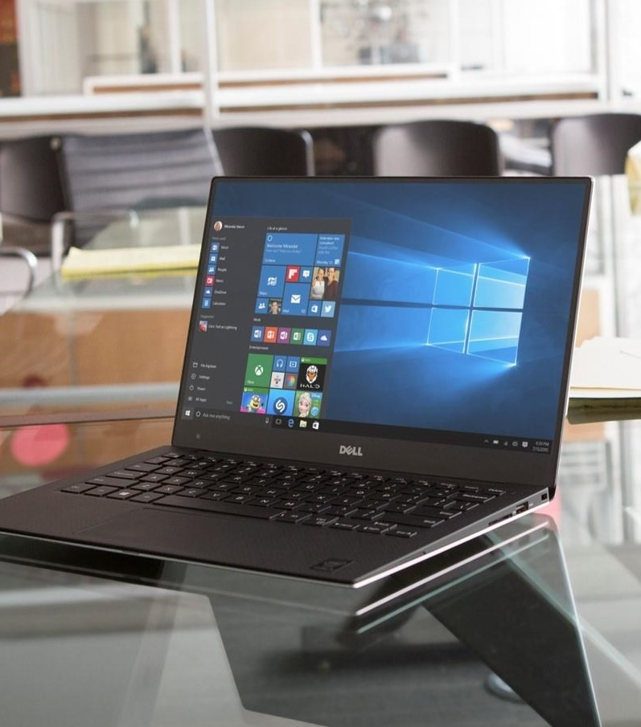
Windows offerings through volume licensing
Hero Commercial Offers:
Windows 10 Enterprise E3
Windows 10 Enterprise E5
Hero EDU Offers:
Windows 10 Education E3
Windows 10 Education E5
Available per user or per device
Other VL Offers:
Windows 10 Pro Upgrade
Windows 10 Enterprise LTSB
Windows Virtual Desktop Access (VDA)* *available per User or per Device
Notes:
The hero commercial offers are Windows 10 Enterprise E3 and E5. E3 is the new name for Windows 10 Enterprise with Software Assurance. E5 is a new top tier enterprise offering. Window 10 Education E3 and E5 are the hero EDU offers. All four of these offers are available per user or per device.
Windows 10 Pro upgrades and Enterprise LTSB upgrades will continue to be available without Software Assurance, and we will continue to offer Windows VDA on per user or a per device basis.

Slide 32
Comparing commercial desktop edition features
 | PRO | ENTERPRISE E3 | ENTERPRISE E5
SECURITY AND IDENTITY
Microsoft Passport | ● | ● | ●
Windows Information Protection | ● | ● | ●
Credential Guard |  | ● | ●
Device Guard |  | ● | ●
Windows Defender Advanced Threat Protection |  |  | ●
MANAGEMENT AND DEPLOYMENT
Domain Join and Azure AD Join | ● | ● | ●
MDM Enablement | ● | ● | ●
Windows Store for Business, Private Catalog | ● | ● | ●
Managed User Experience |  | ● | ●
AppLocker |  | ● | ●
Microsoft Application Virtualization (App-V) |  | ● | ●
Microsoft User Environment Virtualization (UE-V) |  | ● | ●
Cortana Management |  | ● | ●
Windows Store Management |  | ● | ●
Advanced Telemetry Controls |  | ● | ●
FOR A FULL LIST OF FEATURES AND CAPABILITIES PLEASE VISIT THE WEBSITE
Notes:
Pro, Enterprise E3, and Enterprise E5 are the three commercial offers available through volume licensing.
Windows 10 Pro includes all of the great features of Windows 10 Home edition, along with additional security and management features designed to meet the needs of small and medium size businesses.
Windows 10 Enterprise E3 (formerly Windows 10 Enterprise with Software Assurance) builds on Windows 10 Pro with even more security, management, and control features geared toward larger and mid-size organizations or companies of any size with more complex IT requirements, such as those who process sensitive data, operate in a regulated industry, develop software in-house, and/or are publicly listed or planning to issue an IPO.
Windows 10 Enterprise E5 is a new Windows offering that includes everything in E3, with the addition of Windows Defender Advanced Threat Protection (WDATP), a new service that will help enterprise customers detect, investigate and respond to advanced attacks on their networks. Enterprise E5 provides businesses with the maximum level of security available in Windows 10.

Slide 33



INVESTING IN PARTNER PROGRAMS TO DRIVE YOUR SUCCESS
Notes:
What programs and investments is Microsoft making to help you be successful selling Windows 10 next year? A lot! Let’s talk about them…

Slide 34
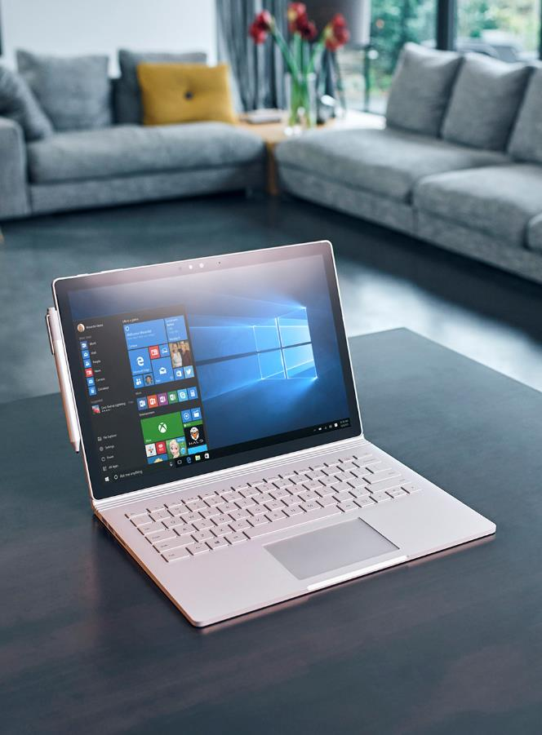
Many Windows FY17 partner programs and initiatives
TYPE | PROGRAMS & INITIATIVES
Events | Accelerate Your Business events (customer events)
 | Device Days events (partner events)
 | Tech-series training events (in-person and online)
Customer Acceleration | Windows Accelerate Program
 | Windows and Office FastTrack Program
 | EMS FastTrack Program
Incentives | OEM ProWins partner incentive
 | VL Partner Discounts
 | ATP rebate offer (to-customer)

Slide 35




Accelerate Your Business adds marketing support
OBJECTIVES
Drive small business customer interest in Windows 10 Pro, new form factors and accelerate Pro device refresh
Showcase new productivity technologies, security tools and form factors
Support OEM partners through PR and media coverage
PROGRAM EXECUTION COMPONENTS
IN PERSON EVENTS
DIGITAL MEDIA & ONLINE CUSTOMER EXPERIENCE
PR & MEDIA
DEVICE OFFER & CONVERSION
CHANNEL AMPLIFICATION
Delivering rich content, small business panels, keynote speakers and device experience
Paid Media & Social Customer impressions delivering Windows 10 Pro Value Prop for SMBs
Driving new stories and editorials for new WIn10 Pro Devices
Providing small business leads to Partners and Resellers
Reseller Demand Generation
& Readiness
250K Customer Engagements
1B Impressions
250+ Press Coverage
150k Referrals to OEMs
15k Sellers Trained
TARGET GOALS
Contact your local Microsoft Partner team for info on events near you.
Notes:
Always on global execution program to nurture new device purchases integrated with “Accelerate your business” customer journey

Slide 36
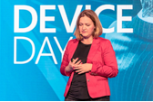
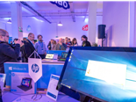
Device Days Plus, the sales training you need Train resellers on selling Windows 10 Pro devices and how to increase attach rate
AUDIENCE
Top to mid-tier resellers sales teams selling to SMB/CA space
LIVE EVENT MATERIALS & SPONSORSHIP
Event-in-a-box materials: Registration website, main presentation deck, demo script, videos, event invite templates, signage design, event hand-outs, eval forms.
Sponsorships: OEM Partner booth and break out sessions for Silver and Gold sponsors
Special Incentive Program or Eval units for attendees only
EVENT AGENDA
Windows across devices, Pro right licensing
Industries and scenarios, testimonial videos
Device demos, compete, objection handling
Cross-selling the stack– Office, Servers
Resources to help drive sales and offers
30-minute break-out session for Gold Sponsors
Microsoft Kiosk to showcase Windows 10 Pro hero devices -> Phone continuum, CTE, IOT
DIGITAL DEVICE DAY ONLINE MODULES
English recorded version delivered in 5-10 minute segments
Online delivery through the Device Partner Center online training engine
WHEN, WHERE, HOW
August to June
120 live Training Events Worldwide, reaching over 10,000 resellers
10 Online-modules for Further Scale
Contact your local Microsoft Partner team for info on events near you.

Slide 37
Windows Partner Tech-Series Program, FY17 End-to-end experience (consumption path)
Goal: 6000 Partners Trained in FY17
SELF-SERVE DIGITAL
PARTNER UNIVERSITY
1:M ONSITE
TARGETED
RSC/RTC
PLANNED
CALLDOWNS
WINDOWS 10
1:1 WINDOWS WORKSHOP
1:1
DEPLOYMENT SHADOWING
“Provide me with some self-consumption content around Windows and help me obtain the competency”
“Help identified Partners understand their options and choose the right technology focus area(s) for their needs”
“Help me understand the next options I have to increase my knowledge”
“Help me build my Windows Practice…”
“Help me with my first Windows deployment(s)”
WINDOWS & DEVICES COMPETENCY
SUBSIDIARY IDENTIFIED
SUBSIDIARY NOMINATED WINDOWS PARTNERS
Notes:
Self-Serve Digital: Partner U with built in Assessment
Planned Call downs: RSC (managed partners) / RTC (unmanaged partners)
After attending an event (remote or onsite), Partner is encouraged to then complete the Windows & Devices competency

Slide 38
Windows Accelerate puts Windows 10 Enterprise in customers’ hands to drive adoption
OVER 2,500 ENGAGEMENTS
IN FY16
CUSTOMER ENGAGEMENT OPPORTUNITY
PROJECT GUIDANCE AND IP PROVIDED BY MICROSOFT
FUNDING TO DELIVER ENGAGEMENT PROVIDED BY MICROSOFT
ENTRYWAY TO ADDITIONAL SERVICE REVENUE OPPORTUNITIES
DEPLOYMENT
SOLUTION
5+ DAY
2–3 DAY
10 DAY
WINDOWS 10 ENTERPRISE POC
BROWSER MIGRATION POC
WINDOWS 10 MOBILITY POC
30–50 DAY
4 DAY
Q1 FY17
NEW
2–4 DAY
Q1 FY17
NEW
WINDOWS 10 ENTERPRISE PILOT
WINDOWS 10 ENTERPRISE COMPATIBILITY BRIEFING
WINDOWS 10 ENTERPRISE SECURITY INTEGRATION BRIEFING
Proof-of-Concept (PoC) takes place in a test environment at the customer location, delivered by MCS or MS certified SI Partners.
Production Pilot takes place in a production environment at the customer location, delivered by MCS or MS certified SI Partners.
Notes:
Windows 10 Enterprise Compatibility Briefing: Aimed at removing the key deployment blocker around App Compatibility while also accelerating the speed of deployment especially among the large enterprise accounts.
Windows 10 Enterprise Security Integration Briefing: Security is a key value driver for Windows 10 and offers a clear and compelling reason for customers to deploy. Features such as Windows Defender ATP, Windows Information Protection and Credential Guard will be included.

Slide 39
ProWins program adds device incentives and support
ProWins Channel incentive design to incentivize sales of commercial devices with Windows Pro
PROGRAM
ProWins Per Unit Incentive
ProWins Accelerator
ProWins CMI
DETAILS
Disti and Reseller payment for all Windows Pro devices sold*
Marketing and training funds to grow Pro devices sales**
Up to $25 per hero device, for commercial marketing investment*
Mix Shift To Commercial/Pro
Sell-through Growth
GOALS
$15M
$5M
$25M
$25M
*Based on Disti reporting data
**Select Distributors and Resellers only
Contact your local Microsoft Partner team for info on this incentive.
Notes:
B3 ProWins
SME: Mary Allen

Slide 40
5 key takeaways from today’s session
This year is the time to deploy Windows 10 – it’s faster and easier than ever
1
Partners tell us profitability is strong with add-on projects and managed services recurring revenues
2
The platform has huge customer value, powerful security, and rocks on new devices
3
We have great new licensing options CSP, E5, E3, Secure Productive Enterprise
4
A host of powerful programs, investments, and resources are here to support you and your customers success
5

Slide 41

Next steps for you to win with Windows 10
Deploy Windows 10 internally
Get trained via MPN and in-country events
Drive Windows 10 deployment and device refresh in every customer
Invest in your security and managed service practices

